Slide 1
LUNGS CANCER PREDICTION USING MACHINE LEARNING
BY
SAKSHAM GUPTA
VIKASH SHARMA
YASH RAJ

Slide 2

Lung Cancer Prediction: A Machine Learning Approach
Lung cancer is a serious health concern globally. This research explores the potential of machine learning to predict lung cancer, aiming to contribute to early detection and improve patient outcomes.

Slide 3
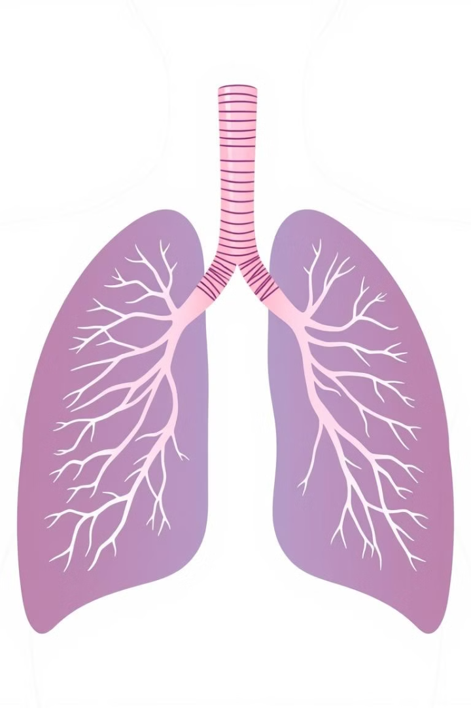
Introduction to Lung Cancer and its Impact
Lung cancer is a leading cause of cancer-related deaths worldwide. It arises from abnormal cell growth in the lungs, often linked to smoking and environmental factors. Early detection is crucial for effective treatment.
1
Types of Lung Cancer
2
Symptoms
Lung cancer can be broadly classified into two major types: small cell lung cancer (SCLC) and non-small cell lung cancer (NSCLC).
Common symptoms include coughing, shortness of breath, chest pain, and weight loss.
3
Impact
Lung cancer has a significant impact on individuals and healthcare systems, leading to reduced quality of life and increased healthcare costs.

Slide 4

Data Acquisition and Preprocessing Techniques
This research utilizes a comprehensive dataset, including patient demographics, medical history, and imaging data, to train and evaluate machine learning models.
Data Transformation
Data Collection
The cleaned data is transformed into a suitable format for machine learning models, including feature scaling and encoding categorical variables.
The dataset is collected from various sources, including hospitals, medical institutions, and public databases.
1
2
3
Data Cleaning
The collected data undergoes rigorous cleaning to handle missing values, inconsistencies, and outliers, ensuring data quality.

Slide 5
Feature Engineering and Selection for Prediction
Feature engineering plays a crucial role in enhancing the predictive power of machine learning models. This involves extracting relevant information from raw data.
Feature Engineering
Feature Selection
Creating new features by combining existing ones or using domain knowledge to represent complex relationships in the data.
Identifying the most informative features that contribute to model performance and eliminating irrelevant features.

Slide 6

Model Development and Selection: Algorithms Used
This research explores various machine learning algorithms, each with its strengths and weaknesses, to identify the most effective model for lung cancer prediction.
Algorithm
Description
Logistic Regression
A linear model used for binary classification, suitable for predicting the probability of lung cancer.
Support Vector Machine (SVM)
A powerful algorithm for classification, capable of finding optimal boundaries between different classes.
Random Forest
An ensemble method that combines multiple decision trees, improving prediction accuracy and robustness.

Slide 7




Model Evaluation and Performance Metrics
The performance of the developed models is rigorously evaluated using appropriate metrics, ensuring the models' reliability and effectiveness in predicting lung cancer.
Accuracy
Precision
Recall
The proportion of correctly predicted cases.
The proportion of correctly predicted positive cases among all cases predicted as positive.
The proportion of correctly predicted positive cases among all actual positive cases.

Slide 8




Results and Discussion of Findings
The results demonstrate the effectiveness of machine learning in predicting lung cancer with promising performance metrics. The study identifies specific factors that contribute to lung cancer development.
High Accuracy
The models achieved high accuracy in predicting lung cancer, indicating their potential for clinical application.
Key Predictors
Certain features, such as age, smoking history, and family history, were identified as strong predictors of lung cancer.
Limitations
The study also acknowledges limitations, such as the availability of data and the need for further validation.

Slide 9

Conclusion and Future Research Directions
This research highlights the potential of machine learning to aid in the early detection and diagnosis of lung cancer. The findings suggest that machine learning models can contribute to personalized medicine and improve patient outcomes.
Future Research
Clinical Applications
Future research should focus on improving model accuracy, incorporating new data sources, and developing more robust and interpretable models.
The models developed in this research have the potential to be implemented in clinical settings, assisting physicians in making informed decisions.

